Slide 1
Object Oriented Programming using C++ 18AIS28 Unit-IV

Slide 2
Inheritance

Slide 3
Inheritance
Inherit the members of an existing class. This existing class is called the base class, and the new class is referred to as the derived class.
Reuse the code functionality and fast implementation time.
NOTE : All members of a class except Private, are inherited

Slide 4
Syntax
class Subclass_name : access_mode Superclass_name
Access Mode is used to specify, the mode in which the properties of superclass will be inherited into subclass, public, private or protected.

Slide 5
EXAMPLE
class Animal // base class
{ public:
int legs = 4;
};
class Dog : public Animal // derived class
{ public:
int tail = 1;
};
int main()
{
Dog d;
cout << d.legs;
cout << d.tail;
}

Slide 6
A derived class inherits all base class methods with the following exceptions:
Constructors, destructors and copy constructors of the base class.
Overloaded operators of the base class.
The friend functions of the base class

Slide 7
Types of inheritance
Single Inheritance
Multiple Inheritance
Hierarchical Inheritance
Multilevel Inheritance
Hybrid Inheritance

Slide 8
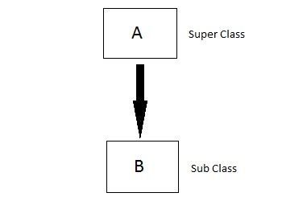
Single inheritance
In this type of inheritance one derived class inherits from only one base class. It is the most simplest form of Inheritance.

Slide 9
Example
class Shape
{
protected:
float width, height;
public:
void set_data (float a, float b)
{
width = a;
height = b;
}
};
class Rectangle: public Shape
{
public:
float area ()
{
return (width * height);
}
};
int main ()
{
Rectangle rect;
rect.set_data (5,3);
cout << rect.area() << endl;
return 0;
}

Slide 10
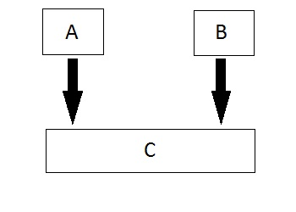
Multiple Inheritance
In this type of inheritance a single derived class may inherit from two or more than two base classes.

Slide 11
Example
class statement:public student,public sports
{
int tot,avg;
public:
void display()
{
tot=(m1+m2+sm);
avg=tot/3;
cout<<"\n\n\tRoll No : "<<rno<<"\n\tTotal : "<<tot;
cout<<"\n\tAverage : "<<avg;
}
};
void main()
{
clrscr();
statement obj;
obj.get();
obj.getsm();
obj.display();
getch();
}
class student
{
protected:
int rno,m1,m2;
public:
void get()
{
cout<<"Enter the Roll no :";
cin>>rno;
cout<<"Enter the two marks :";
cin>>m1>>m2;
}
};
class sports
{
protected:
int sm; // sm = Sports mark
public:
void getsm()
{
cout<<"\nEnter the sports marks :";
cin>>sm;
}
};

Slide 12
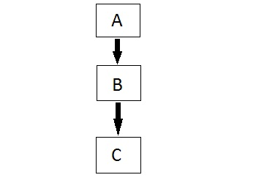
Multilevel Inheritance
In this type of inheritance the derived class inherits from a class, which in turn inherits from some other class. The Super class for one, is sub class for the other.

Slide 13
example
using namespace std;
class base //single base class
{
public:
int x;
void getdata()
{
cout << "Enter value of x= "; cin >> x;
}
};
class derive1 : public base // derived class from base class
{
public:
int y;
void readdata()
{
cout << "\nEnter value of y= "; cin >> y;
}
};
class derive2 : public derive1 // derived from class derive1
{
private:
int z;
public:
void indata()
{
cout << "\nEnter value of z= "; cin >> z;
}
void product()
{
cout << "\nProduct= " << x * y * z;
}
};
int main()
{
derive2 a; //object of derived class
a.getdata();
a.readdata();
a.indata();
a.product();
return 0;
} //end of program

Slide 14
Virtual base class
Multiple inheritance may lead to duplication of inherited members from a grandparent base class. This may be avoided by making the common base class a virtual base class. When a class is made a virtual base class, C++ takes necessary care to see that only one copy of that class is inherited

Slide 15
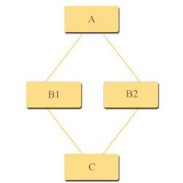
EXAMPLE
class A
{
.....
};
class B1 : virtual public A
{
.....
};
class B2 : virtual public A
{
.....
};
class C : public B1, public B2
{
.....// only one copy of A
.....// will be inherited
};

Slide 16
class student {
int rno;
public:
void getnumber() {
cout << "Enter Roll No:";
cin>>rno;
}
void putnumber() {
cout << "\n\n\tRoll No:" << rno << "\n";
}
};
class test : public virtual student {
public:
int part1, part2;
void getmarks() {
cout << "Enter Marks\n";
cout << "Part1:";
cin>>part1;
cout << "Part2:";
cin>>part2;
}
void putmarks() {
cout << "\tMarks Obtained\n";
cout << "\n\tPart1:" << part1;
cout << "\n\tPart2:" << part2;
}
};
class sports : public virtual student {
public:
int score;
void getscore() {
cout << "Enter Sports Score:";
cin>>score;
}
void putscore() {
cout << "\n\tSports Score is:" << score;
}
};

Slide 17
class result : public test, public sports {
int total;
public:
void display() {
total = part1 + part2 + score;
putnumber();
putmarks();
putscore();
cout << "\n\tTotal Score:" << total;
}
};
void main() {
result obj;
clrscr();
obj.getnumber();
obj.getmarks();
obj.getscore();
obj.display();
getch();
}

Slide 18
POINTERS

Slide 19
pointers
A pointer is a variable used to store the address of a memory cell. We can use the pointer to reference this memory cell
datatype *var-name;
Memory address:
1020
1024
1032
…
…
100
…
1024
…
integer
pointer

Slide 20
operations
we define a pointer variables
assign the address of a variable to a pointer and
finally access the value at the address available in the pointer variable. This is done by using unary operator * that returns the value of the variable located at the address specified by its operand

Slide 21
Pointer variable
Declaration of Pointer variables
type* pointer_name;
//or
type *pointer_name;
where type is the type of data pointed to (e.g. int, char, double)
Examples:
int *n;
RationalNumber *r;

Slide 22
Address operator &
The "address of " operator (&) gives the memory address of the variable
Memory address:
1020
1024
…
…
100
…
…
…
a
int a = 100;
//get the value,
cout << a; //prints 100
//get the memory address
cout << &a; //prints 1024

Slide 23
example
int a = 100, b = 88, c = 8;
int *p1 = &a, *p2, *p3 = &c;
p2 = &b; // p2 points to b
p2 = p1; // p2 points to a
b = *p3; //assign c to b
*p2 = *p3; //assign c to a
cout << a << b << c;
?

Slide 24
pointer to object
class myclass
{
int i;
public:
void read(int j)
{
i= j;
}
int getint()
{
return i;
}
};
void main()
{
clrscr();
myclass ob, *objectPointer;
objectPointer = &ob; // get address of ob
objectPointer->read(10);
cout<<objectPointer->getint(); // use -> to call getlnt()
getch();
}

Slide 25
this pointer
class Test
{
private:
int x;
public:
void setX (int x)
{
// The 'this' pointer is used to retrieve the object's x
// hidden by the local variable 'x'
this->x = x;
}
void print() { cout << "x = " << x << endl; }
};
int main()
{
Test obj;
int x = 20;
obj.setX(x);
obj.print();
return 0;
}

Slide 26
Virtual functions

Slide 27
Virtual functions
Virtual Function is a function in base class, which is overrided in the derived class
Virtual Keyword is used to make a member function of the base class Virtual.

Slide 28
Problem without Virtual Keyword
class Base
{
public:
void show()
{
cout << "Base class";
}
};
class Derived:public Base
{
public:
void show()
{
cout << "Derived Class";
}
};
int main()
{
Base* b; //Base class pointer
Derived d; //Derived class object
b->display();
b = &d;
b->display();
return 0;
}
Output:
Base class
Base class

Slide 29
using Virtual Keyword
class Base
{
public:
virtual void show()
{
cout << "Base class";
}
};
class Derived:public Base
{
public:
void show()
{
cout << "Derived Class";
}
};
int main()
{
Base* b; //Base class pointer
Derived d; //Derived class object
b = &d;
b->show();
return 0;
}
Output:
Derived Class

Slide 30
Abstract Class
If a base class contains at least one virtual function then, that class is known as abstract class.

Slide 31
EXAMPLE
class Circle : public Shape
{
public:
float area()
{ return 3.14*l*l; }
};
int main()
{
Square s;
Circle c;
cout<<"Enter length to cal. area of a square: ";
s.get_data();
cout<<"Area of square: "<<s.area();
cout<<"\nEnter radius to calcuate area of a circle:";
c.get_data();
cout<<"Area of circle: "<<c.area();
return 0;
}
.
class Shape //Abstract class
{
protected:
float l;
public:
void get_data() //Note: this fn is not virtual
{
cin>>l;
}
virtual float area() // virtual function
};
class Square : public Shape
{
public:
float area()
{ return l*l; }
};

Slide 32
PURE VIRTUAL FUNCTION
If expression =0 is added to a virtual function then, that function becomes pure virtual function.
Note that, adding =0 to virtual function does not assign value, it simply indicates the virtual function is a pure function.
If a base class contains at least one virtual function then, that class is known as abstract class.

Slide 33
EXAMPLE
class Circle : public Shape
{
public:
float area()
{ return 3.14*l*l; }
};
int main()
{
Square s;
Circle c;
cout<<"Enter length to cal. area of a square: ";
s.get_data();
cout<<"Area of square: "<<s.area();
cout<<"\nEnter radius to calcuate area of a circle:";
c.get_data();
cout<<"Area of circle: "<<c.area();
return 0;
}
.
class Shape //Abstract class
{
protected:
float l;
public:
void get_data() //Note: this fn is not virtual
{
cin>>l;
}
virtual float area() = 0 ; // PURE virtual function
};
class Square : public Shape
{
public:
float area()
{ return l*l; }
};
In this program, pure virtual function virtual float area() = 0; is defined inside class Shape, so this class is an abstract class and you cannot create object of class Shape

